Slide 1
MACHINE LEARNING MICRO PROJECT – HR DATASET ANALYSIS
By - VARSHINI SREE J K

Slide 2
PROBLEM STATEMENT - Uncovering Employee Attrition Patterns in the HR Dataset
Employee attrition poses a significant challenge for organizations, impacting productivity, morale, and overall business performance. The HR dataset provides valuable attributes that can be leveraged to uncover insights into the factors influencing employee attrition.
Objective:
The primary objective of this study is to analyse the HR dataset to identify patterns and trends associated with employee attrition. By delving into the provided attributes, we aim to answer key questions and provide actionable insights for the organization:

Slide 3
DATASET OVERVIEW
The dataset comprises of 917 rows.
It comprises of 35 columns
Further, the size of the dataset is 30295
This analysis aims to equip the organization with data-driven insights to implement effective retention strategies and enhance overall employee satisfaction and engagement.

Slide 4
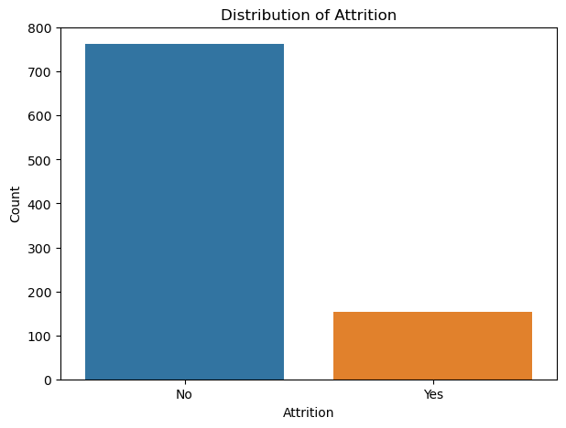
ATTIRITION – HANDLING IMBALANCED DATA
INSIGHTS
ATTRITION DISTRIBUTION
Majority of the instances in Attrition falls under ‘No’ which indicates that the employees haven’t experienced attrition.
The target variable Attrition possess imbalance dataset
To balance the dataset the following process are done
Handling zero values
Performing Data Transformation (Log transformation and Square root transformation)

Slide 5
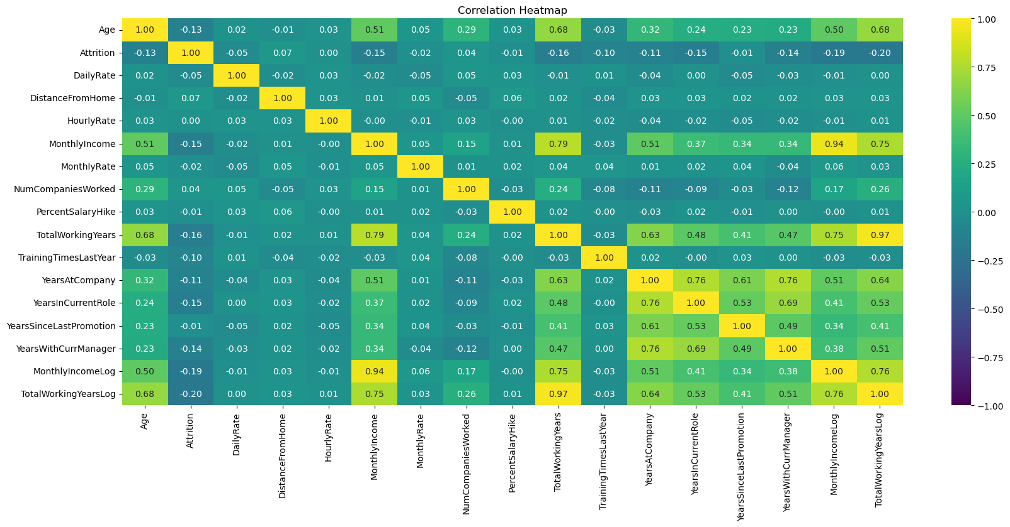
CORRELATION ANALYSIS
Based on the correlation matrix there are 5 features which posses high correlation (threshold > 07.5)
MonthlyIncomeLog
TotalWorkingYears
TotalWorkingYearsLog
YearsInCurrentRole
YearsWithCurrentManager
These features are dropped in order to remove redundancy it would carry on the target variable ‘Attrition’.
Also, removing highly correlated features can improve model performance.

Slide 6
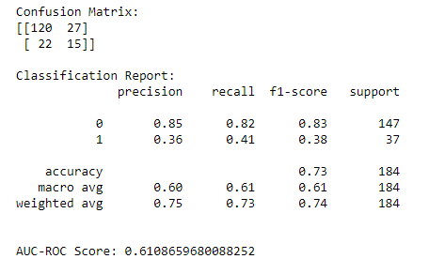
DECISION TREE – WITHOUT HYPERPARAMETER TUNING
The confusion matrix with TP-15, TN-120, FP-27, FN-22 shows that there is some ability to correctly identify cases of ‘No’ Attrition but struggles in predicting ‘Attrition’.
The AUC-ROC score is 0.61, indicating a modest ability of the model to distinguish between the two classes.
The overall accuracy of the model is 73.37%, representing the proportion of correctly predicted instances over the total.

Slide 7
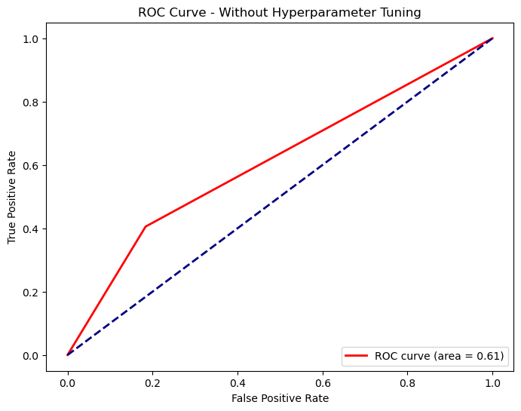
DECISION TREE ROC CURVE – WITHOUT HYPERPARAMETER TUNING
The ROC Curve visualizes the trade-off between True Positive Rate (Sensitivity) and False Positive Rate (1 - Specificity) across different classification thresholds.
An AUC of 0.61 indicates a modest ability of the model to distinguish between the two classes (Attrition and No Attrition).

Slide 8
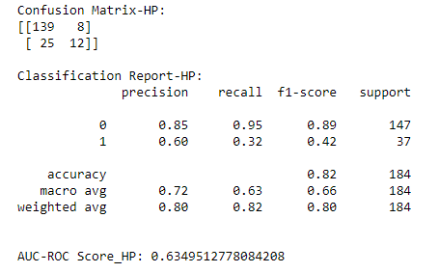
DECISION TREE – WITH HYPERPARAMTER TUNING
The AUC-ROC score is 0.63, indicating a moderate ability of the tuned model to discriminate between the two classes. This score ranges from 0 to 1, with higher values suggesting better discrimination
The tuned model achieves an accuracy of 82.07%, representing the proportion of correctly classified instances out of the total.
The model achieved 82% accuracy with the best hyperparameters after tuning

Slide 9
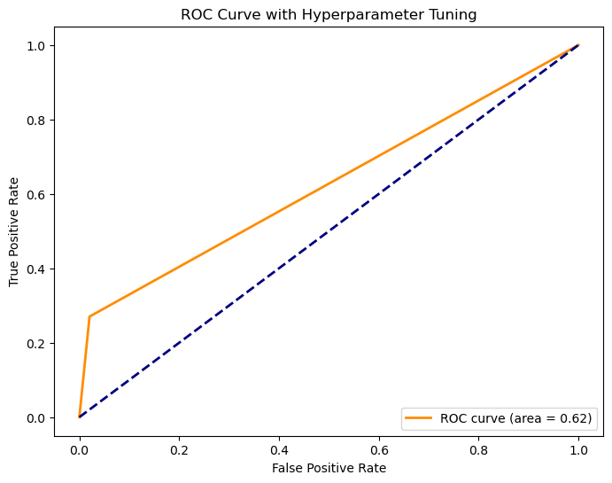
DECISION TREE ROC CURVE – WITH HYPERPARAMETER TUNING
The model with hyperparameter tuning shows a significant improvement in accuracy (73.37% to 82.07%).
The model with hyperparameter tuning continues to demonstrate higher accuracy and improved predictive capabilities compared to the model without hyperparameter tuning.
The ROC curve area of 0.62 indicates good discriminative power in identifying instances of attrition.

Slide 10
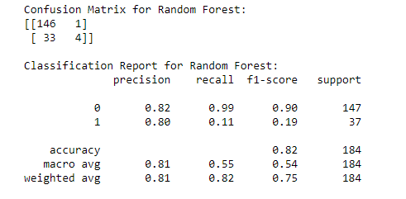
RANDOM FOREST – WITHOUT HYPERPARAMETER TUNING
The model achieved an overall accuracy of 81.52%, indicating that it correctly predicted the target variable for approximately 81.52% of the samples.
The model shows high precision for Class 0 but struggles to correctly identify instances of Class 1
The model has a trade-off between precision and recall, particularly for Class 1

Slide 11
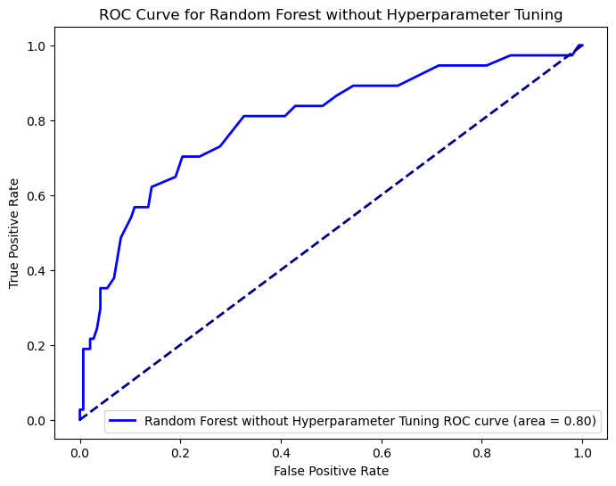
RANDOM FOREST ROC CURVE – WITHOUT HYPERPARAMTER TUNING
The Area Under the Receiver Operating Characteristic (ROC) Curve (AUC-ROC) score for the Random Forest model is 0.7969, which is approximately 80%.
This score represents the model's ability to distinguish between the two classes. A higher AUC-ROC score indicates better performance
The model demonstrates a strong ability to discriminate between employees with attrition and those without.

Slide 12
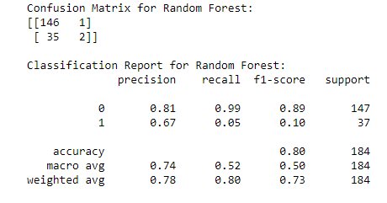
RANDOM FOREST WITH HYPERPARAMTER TUNING
The accuracy of the Random Forest model with hyperparameter tuning is approximately 80.43%. This metric reflects the overall correctness of the model's predictions.
The model performs well in predicting instances of employees who did not leave the company (high precision and recall for Class 0).
F1-Score highlights the trade-off between precision and recall, providing a comprehensive metric for model evaluation

Slide 13
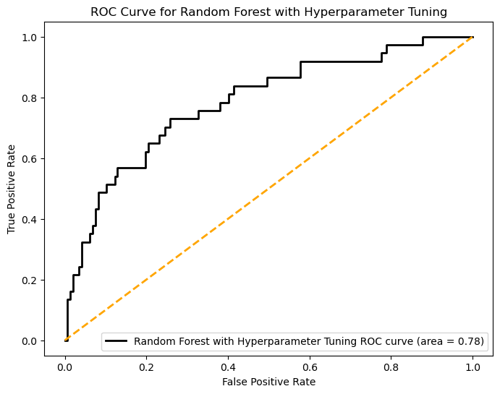
RANDOM FOREST ROC CURVE – WITH HYPERPARAMETER TUNING
An AUC-ROC score of 0.78 indicates a satisfactory performance, with a significant area under the ROC curve
The ROC curve area, combined with the AUC-ROC score, demonstrates the model's effectiveness in differentiating between positive and negative instances.

Slide 14
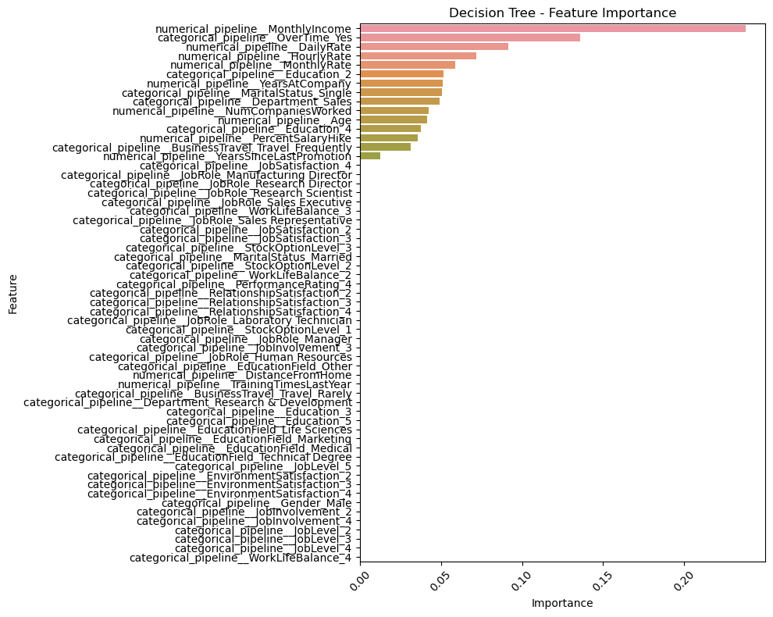
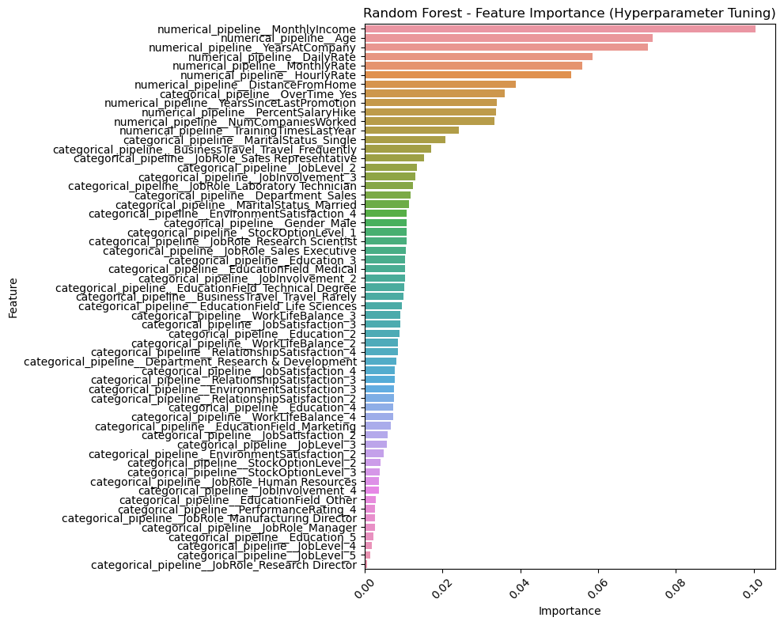
FEATURE IMPORTANCE – DECISION TREE AND RANDOM FOREST
DECISION TREE
RANDOM FOREST

Slide 15
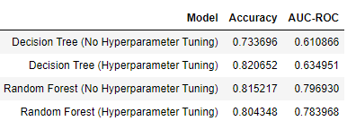
MODEL COMPARISON
Both Decision Tree and Random Forest models demonstrated improvements with hyperparameter tuning
The Decision Tree model with tuning outperformed the Random Forest model in terms of accuracy (82.07% vs. 80.43%) but had a similar AUC-ROC score.
In summary, the Decision Tree model, particularly after hyperparameter tuning, seems to strike a balance between interpretability and performance

Slide 16
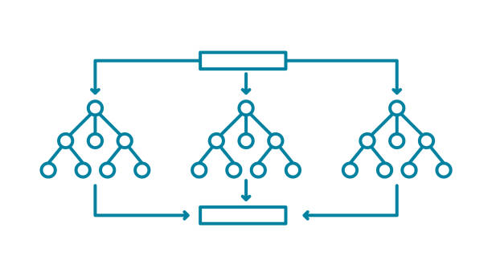
POST MODEL CONCLUSION – CHOOSING THE BEST MODEL
The Decision Tree with Hyperparameter Tuning outperformed other models in terms of accuracy and AUC-ROC on the given dataset.
Decision Trees provide a good balance between interpretability and performance.
Suggestions to the organisation:
Implement decision tree model with hyperparameter tuning
Continuous monitoring of the model’s performance.
Performing ensemble techniques.
By implementing the Decision Tree model with Hyperparameter Tuning and incorporating the suggested strategies, the organization can make informed decisions to mitigate employee attrition and foster a healthier work environment.

